Slide 1
POWER POINT PRESENTATION OF DATA ANALYSIS AND VISUALIZATION DONE ON AN AIRLINE DATAset (CODE APRIL)
BY:
IGBINEDION JOSHUA EHUNWUNSE
(@joshNED)
(INTERMEDIATE DATA SCIENTIST)

Slide 2
AIM AND OBJECTIVES
The aim of this Data analysis project is to get hands on real life dataset, put my acquired data analysis skills to use and to test how well I have grown in the Data science sector of the Tech industry.
Objectives include:
To load the dataset from the link provided
To carry out data cleaning/manipulation on the loaded dataset and display it in an “easy to read and understand” format
To carry out Exploratory Data Analysis (EDTA) on the data in order to draw meaning insights from the dataset
To display my findings where applicable in graphs and charts to make it more understandable (Data Visualization)

Slide 3
DATA SOURCE
The dataset was gotten from Kaggle through a link provided by the Director of Code April 2024, Miss Promise Ekeh.
Link: https://www.kaggle.com/datasets/iamsouravbanerjee/airline-dataset

Slide 4
METHODOLOGY
The methodology and work flow employed for this project are as follows:
The dataset was first downloaded to my PC to make it more easier to load and work on, especially in a case of failed or weak internet connection.
The dataset was loaded as a pandas DataFrame into Jupyter notebook
Data cleaning was carried out on the dataset. Thankfully, there was no missing or null value in each column. The first names and last names of each Traveler were merged into one column. Some characters were replaced and some new columns were created to aid better understanding.
EDTA was carried out on the cleaned dataset and meaningful insights were gotten.
The data was visualized where applicable and meaningful insights were gotten as well.

Slide 5
BASIC INFORMATION OF THE DATASET AFTER CLEANING and (EDTA)
The cleaned data had 98619 rows and 15 columns. Meaning it had 98619 booked flights with the names and other details of the Travelers on different columns.
The data contained 98610 different booked Travelers i.e without repetition of Traveler name.
The data contained 98605 different Pilots i.e without repetition of Pilot name.
The data contained only one numerical data. i.e Age of Travelers
From the dataset, some flights were cancelled, some were delayed while some happened on time.

Slide 6
BASIC INFORMATION OF THE DATASET AFTER CLEANING Cont’d (EDTA)
The dataset has more booked male Travelers (49598) than female travelers (49021).
To give a keen focus on the successful flights (Delayed flights and on time flights), the cancelled flights were dropped and a new dataframe was created.
The new dataframe contains 65677 travelers. This to say that a total of 32942 flights were cancelled.
A third dataframe was later created to give focus on the 32942 cancelled flights.
The oldest set of Travelers were 90 years old and the youngest were a year old. This is to say that age was never a deter in airspace travels.
REFER TO JUPYTER NOTEBOOK TO CONFIRM ANALYSIS AND VIEW MORE INSIGHTS GOTTEN

Slide 7
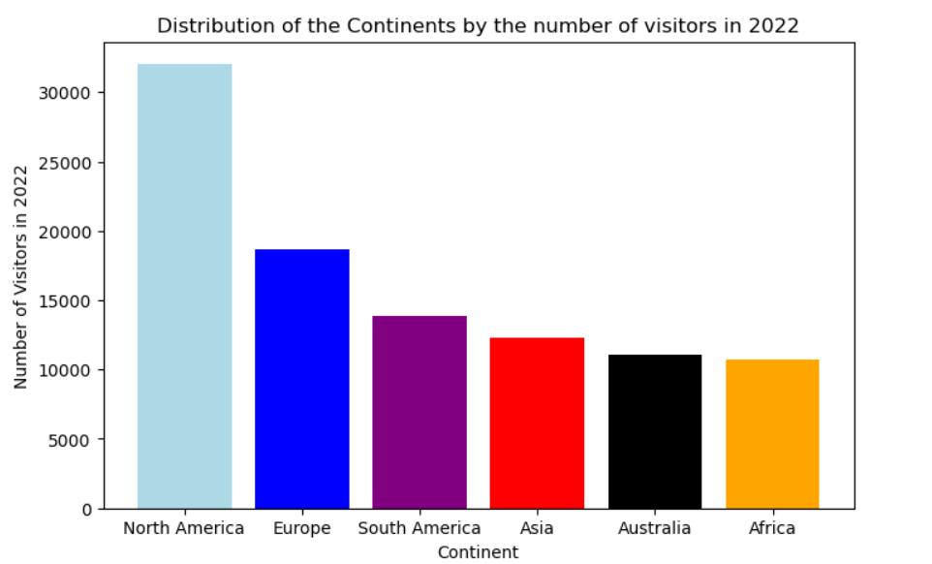
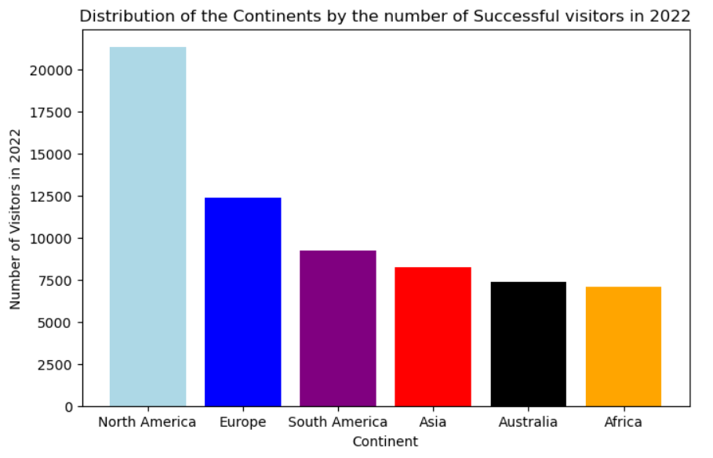
DATA VISUALIZATION AND INSIGHTS
INSIGHT: From the above displayed bar charts, it can be seen that the most booked continental flight (bar chart on the left) and most visited continents (bar chart on the right) by the Travelers are North America, Europe, South America, Asia, Australia and Africa in a descending order. Irrespective of the cancelled flights, the most preferred continent by Travelers remains NORT AMERICA
ADVICE: More flight arrangement should be made for the top three continents since they have a larger number of visitors per year.
N/B: YOU CAN SPOT THE DIFFERENCE ON BOTH PLOTS BY COMPARING THE VALUES ON THE VERTICAL AXIS

Slide 8
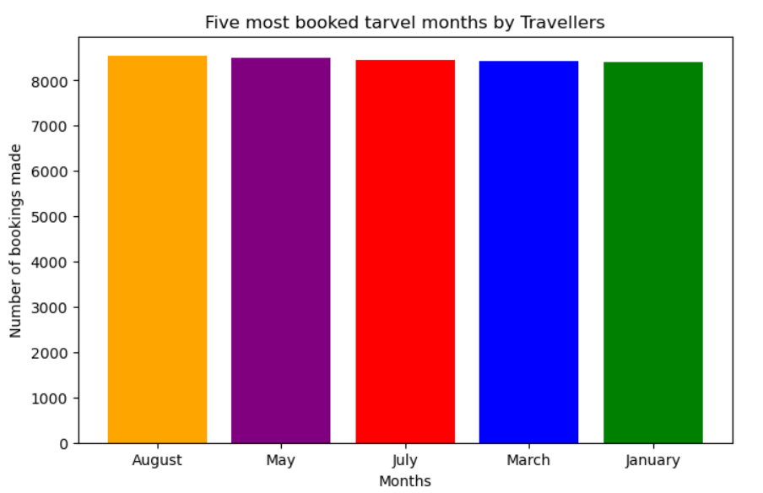
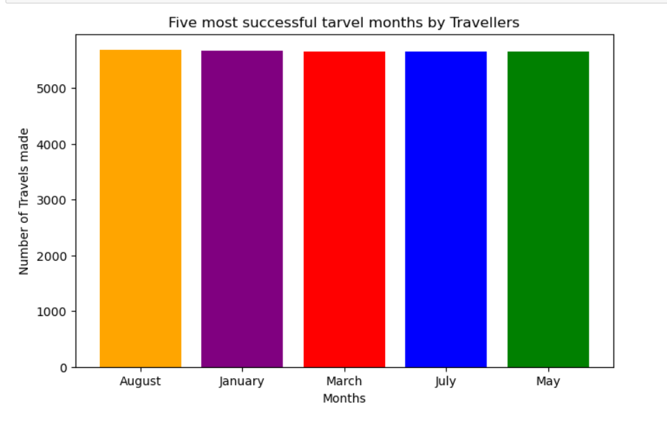
DATA VISUALIZATION AND INSIGHTS cont’d
INSIGHT: From the displayed bar charts above, it can be seen that the months with the highest bookings (bar chart on the left) were August, May, July, March and January in a decreasing order while the successful flights i.e aside cancelled flights (bar chart on the right) were in August, January, March, July and May.
FINDINGS: Most flights were cancelled in May and July. This is probably tied to weather conditions. May and July are the peaks of the rainy season hence more flights were cancelled due to bad weather conditions. August is actually the peak for airspace travels.
N/B: YOU CAN SPOT THE DIFFERENCE ON BOTH PLOTS BY COMPARING THE VALUES ON THE VERTICAL AXIS

Slide 9
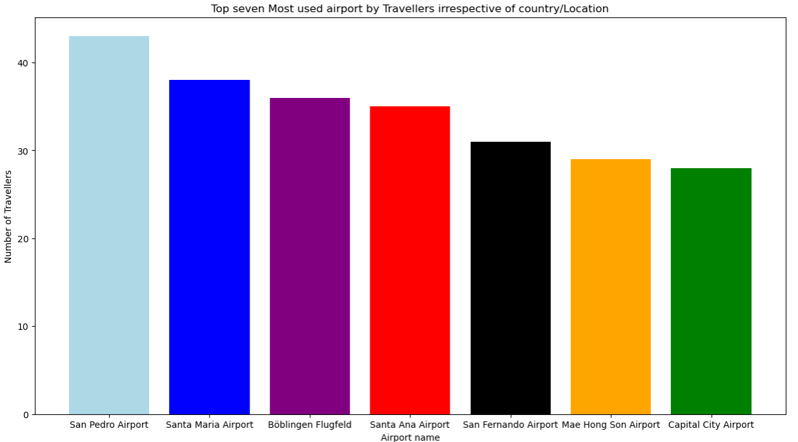
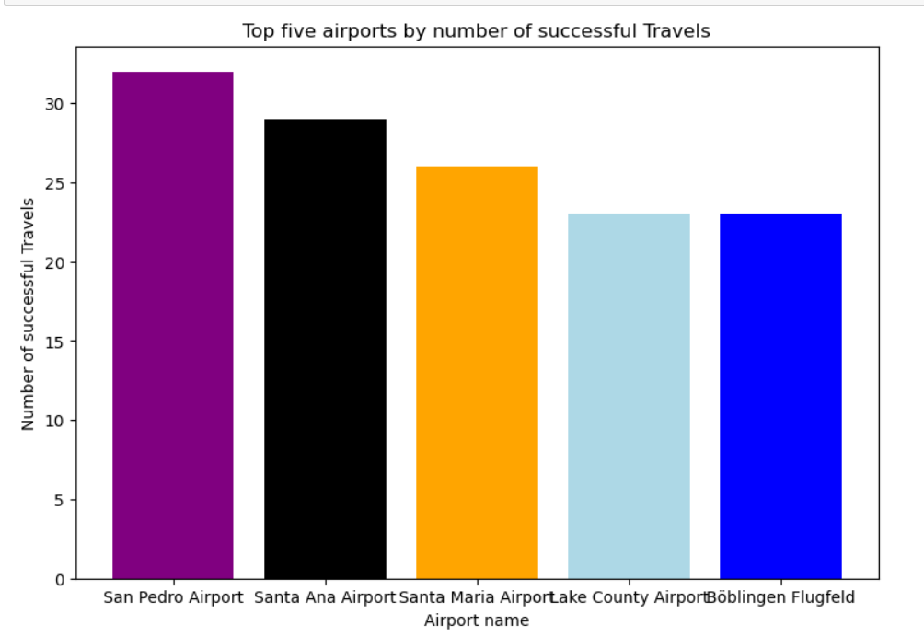
DATA VISUALIZATION AND INSIGHTS cont’d
INSIGHT/FINDINGS: From the displayed bar charts above, it can be seen that the Airports with the highest number of bookings (bar chart on the left) were San Pedro Airport to Capital city Airport in a decreasing order. However, from the bar chart on the right, it can be seen that Boblingen Flugfeld, San Fernanado, Mae Hong, and Capital city Airports had most of their flights cancelled even though they got high number of bookings.
ADVICE: Boblingen Flugfeld, San Fernanado, Mae Hong, and Capital city Airports had most of their flights cancelled for 2022. So they won’t be great options if swift or emergency travels/flights are to be made. Secondly, the said Airports should try to work on their flight deliveries in order to avoid more cancelled flight occurrence in future.
N/B: YOU CAN SPOT THE DIFFERENCE ON BOTH PLOTS BY COMPARING THE VALUES ON THE VERTICAL AXIS

Slide 10
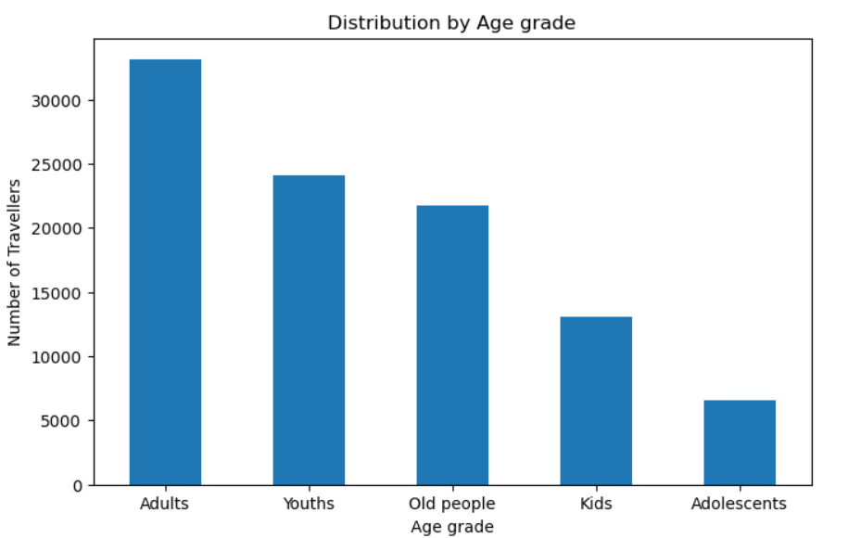
DATA VISUALIZATION AND INSIGHTS cont’d
INSIGHT/FINDINGS: From the above bar chart, it can be seen that Adults (between 40 to 70years) tops the chart in terms of the number of bookings made. It can therefore be concluded that travelers within the age range of 40 – 70 years make the highest number of travels. This is seconded by Youths within the age range of 18 – 40 years. Adolescents within the age range of 12- 18 make the least number of bookings/travels.

Slide 11
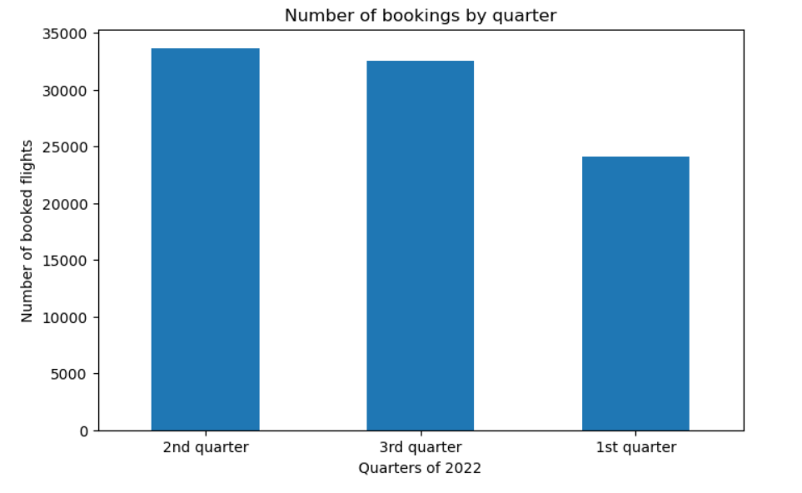
DATA VISUALIZATION AND INSIGHTS cont’d
INSIGHT/FINDINGS: From the above bar chart, it can be seen that most of the bookings/travels occurred within the second quarter of the year (May to August). This is followed by the number of travels in the 3rd quarter of the year. The 1st quarter of the year has the least number of bookings.
ADVICE: From the analysis, the boom of flight bookings happens in the 2nd quarter of the year through the 3rd quarter. The aviation sector should always prepare for this boom to make a lot of profits from the bookings.

Slide 12
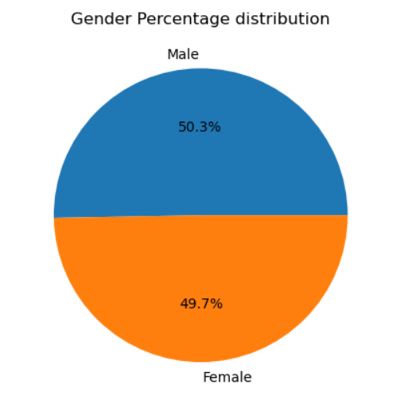
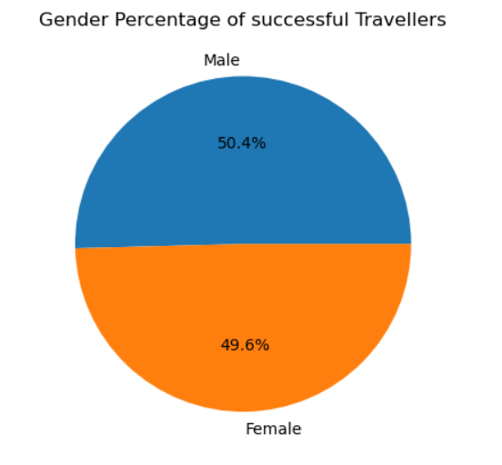
DATA VISUALIZATION AND INSIGHTS cont’d
INSIGHT/FINDINGS: From the above pie charts, it can be seen that the airline travels/bookings have a higher percentage of male Travelers or passengers compared to female passengers. In this case, the pie chart on the right shows the gender percentage distribution of the total bookings received while the pie chart on the right shows the gender percentage distribution of the total successful airline travelers for the year.
ADVICE: From the analysis, if gender based decisions or preparations are to be made in any aircraft, the male gender should be allocated a higher interest than the female gender.

Slide 13
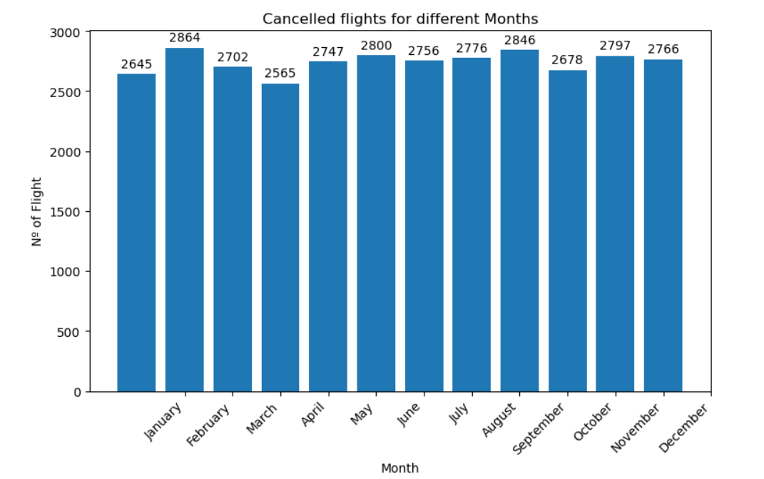
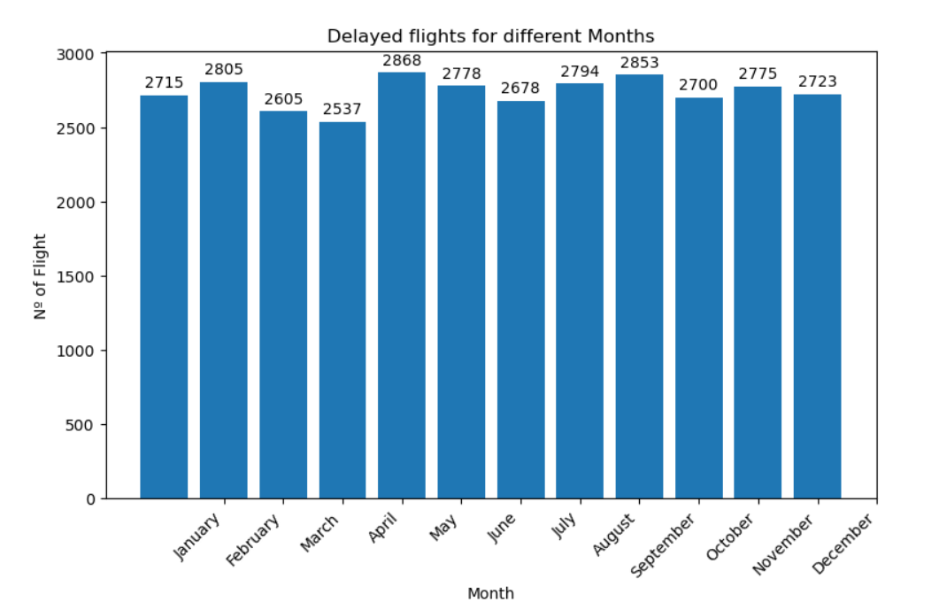
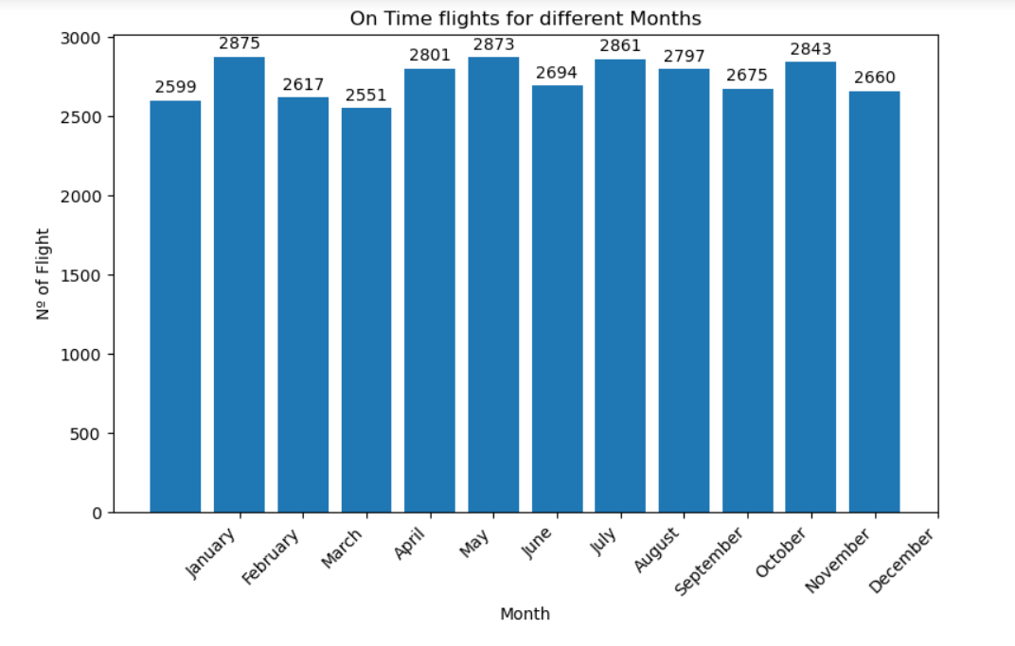
DATA VISUALIZATION AND INSIGHTS cont’d
The three charts display the number of Cancelled flights, Delayed flights, and On time flights of the year per month.

Slide 14
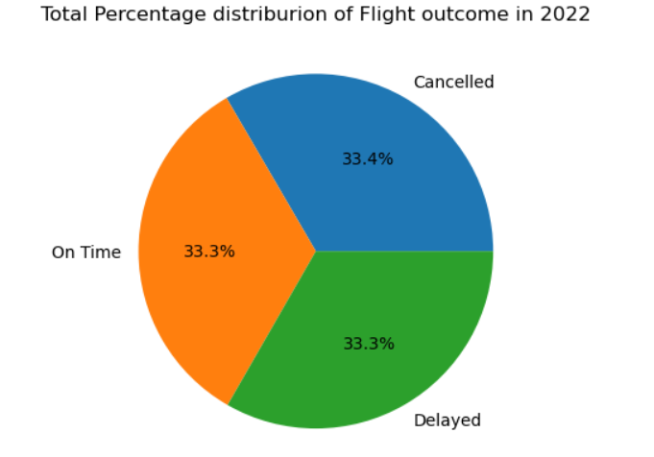
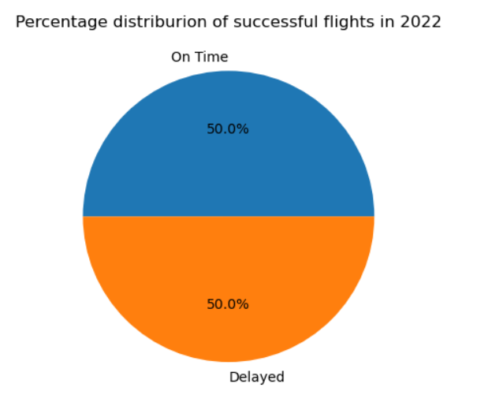
DATA VISUALIZATION AND INSIGHTS cont’d
INSIGHT/FINDINGS: From the above pie charts, it can be seen from the pie chart on the left that a higher percentage of the flight were cancelled compared to the Delayed and on time fights individually. From the other pie chart, it can be seen that there were almost equal chances that the flight will be on time or delayed.
ADVICE: From the analysis, the airline is advised to work on their flight deliveries in order to reduce the percentage of cancelled flights in the coming years. Secondly, they are to work on the flight delay mechanism so as to improve the percentage of swift (on time) flights over delayed flights.

Slide 15
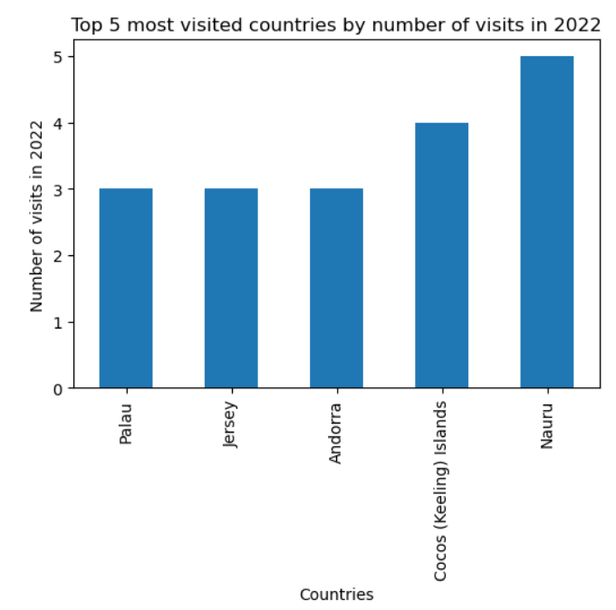
DATA VISUALIZATION AND INSIGHTS cont’d
INSIGHT/FINDINGS: The bar chart above shows the top five most visited countries in an increasing order.
ADVICE: More flight arrangement should be made for these countries in the coming year. Since they have a large number of visitors per year.

Slide 16
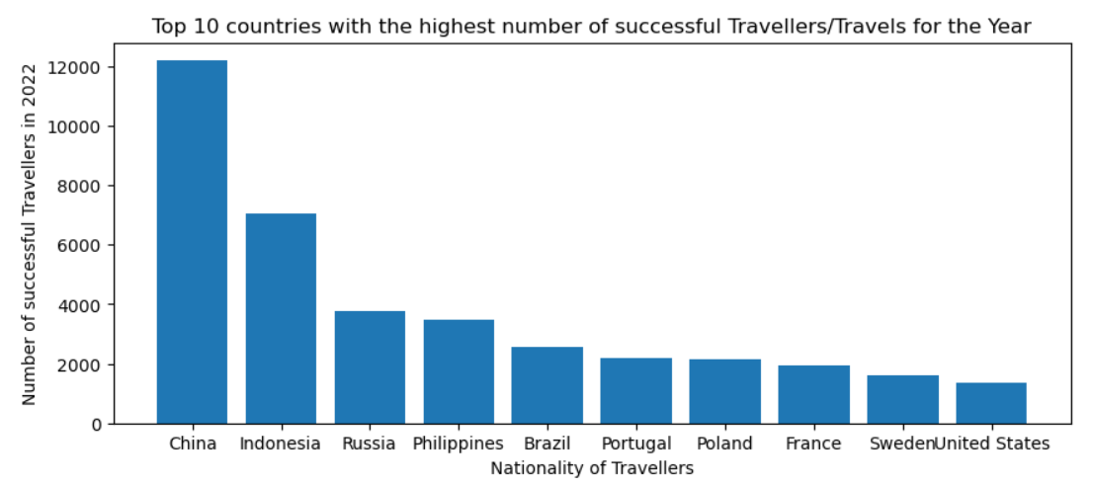
DATA VISUALIZATION AND INSIGHTS cont’d
INSIGHT/FINDINGS: The bar chart above shows the top ten countries with the highest number of travelling Citizens in a decreasing number. From the chart, we can see that the best Country citizens that patronize the airline are the Chinese (China in diaspora).
ADVICE: A renowned focus should be placed on these countries to increase or improve the airline service delivery.

Slide 17
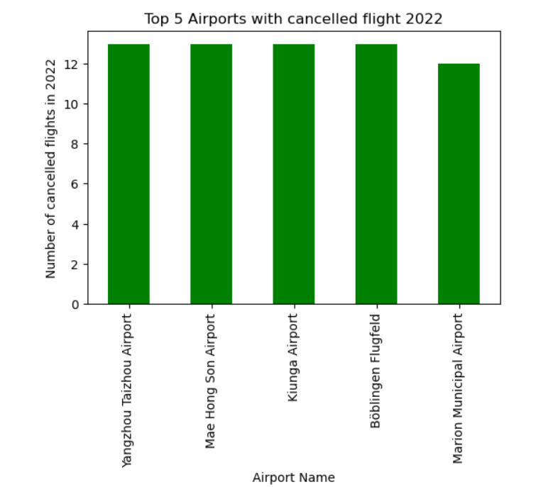
DATA VISUALIZATION AND INSIGHTS cont’d
INSIGHT/FINDINGS: The bar chart above shows the top five Airports with the highest number of cancelled flights in a decreasing number.
ADVICE: The above Airports are to focus more on their flight delivery if they are to remain in the top spot in the viation sector.

Slide 18
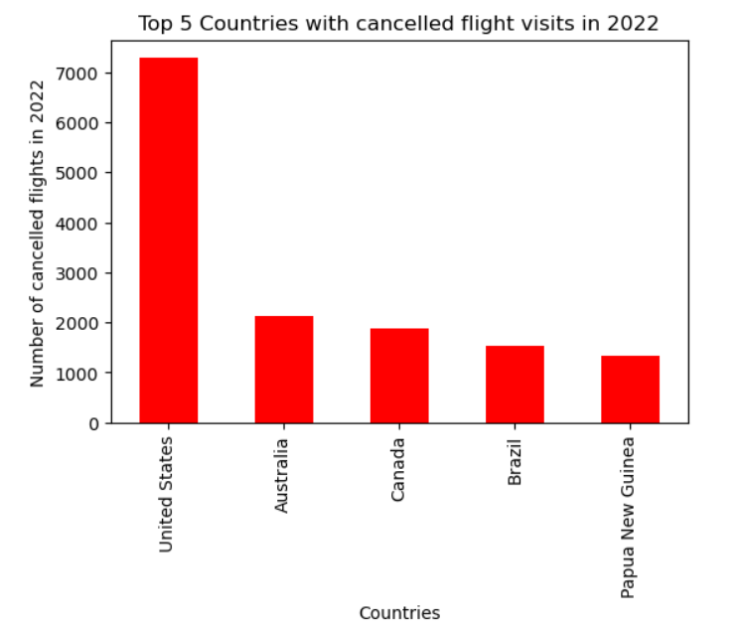
DATA VISUALIZATION AND INSIGHTS cont’d
INSIGHT/FINDINGS: The bar chart above shows the top five destination Countries with the highest number of cancelled flights in a decreasing number. From the above chart, it can be seen that United states would have gotten the highest number of visitors in 2022 if not that most of the flights were cancelled.
ADVICE: A special arrangement should be made for Travelers going to these top five Countries in the coming Years so as not to have a repeat of this.

Slide 19
CONCLUSION
A detailed Data analysis has been carried out on the dataset provided. Numerous insights were gotten and meaningful advice were given on the slides. Please refer to the Jupyter notebook to view the solutions and other insights that weren’t captured on the slides.

Slide 20
THANK
YOU
Presented by Joshua @JoshNed
(Code April 2024)
Directed and sponsored by Promise Ekeh

